Slide 1
RESEARCH WEBS
MECHANISMS and KEY TERMS / PHRASES
USING TECHNOLOGYSTUDENT.COM TO FIND INFORMATION
To help you ﬁnd the information you need, use the ‘search’ function at the bottom of any page of technologystudent.com. The majority of the answers will be found on this website.
For any other information, use a search engine such as Google.
HELPFUL TIP
When using the search function, at the bottom of each page of technologystudent.com, select this option.
WORLD ASSOCIATION OF TECHNOLOGY TEACHERS
https://www.facebook.com/groups/254963448192823/
www.technologystudent.com © 2020 V.Ryan © 2020

Slide 2
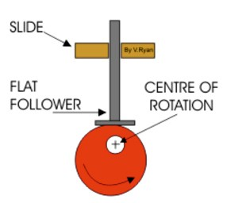
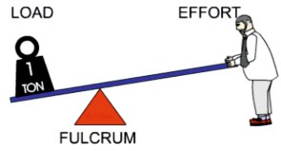
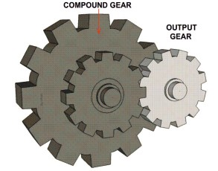
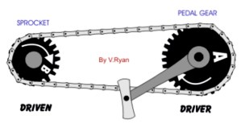
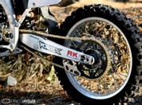
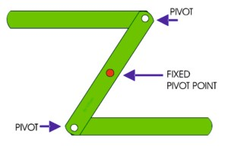
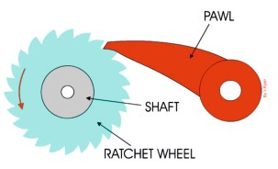
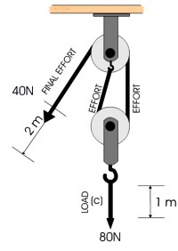
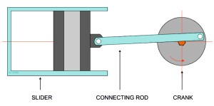
REVISION WEB - MECHANISMS
WORLD ASSOCIATION OF TECHNOLOGY TEACHERS https://www.facebook.com/groups/254963448192823/
www.technologystudent.com © 2017 V.Ryan © 2017
RESEARCH EACH OF THE MECHANISMS. WRITE KEY FACTS ABOUT EACH MECHANISM, ON THE REVISION WEB. ADD A SMALL IMAGE(S), SUCH AS A PRACTICAL APPLICATION. AN EXAMPLE HAS BEEN COMPLETED FOR YOU.
CAMS
LEVERS
Bicycle / motorbike
Transmits power
Many practical applications
GEARS
in machines
CHAIN AND SPROCKET
Positive speed ratio
QUICK RETURN MECHANISM
LINKAGES
RATCHET MECHANISM
CRANK AND SLIDER
PULLEYS

Slide 3
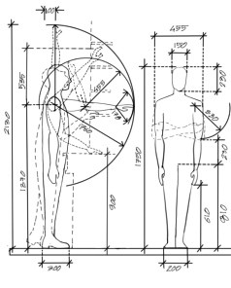
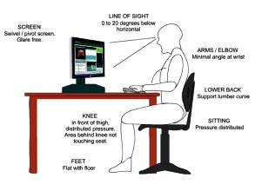
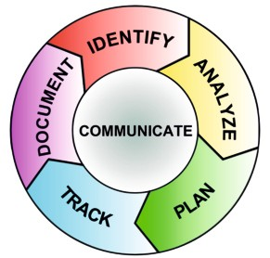
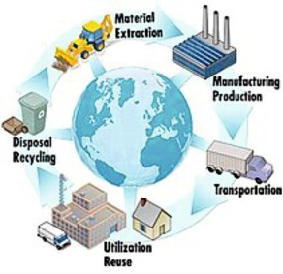
REVISION WEB - KEY DESIGN TERMS / PHRASES
WORLD ASSOCIATION OF TECHNOLOGY TEACHERS https://www.facebook.com/groups/254963448192823/
www.technologystudent.com © 2017 V.Ryan © 2017
RESEARCH EACH OF THE KEY WORDS/PHRASES AND WRITE FACTS ON THE REVISION WEB. ADD A SMALL IMAGE(S) FOR EACH OF THE WORDS/PHRASES. AN EXAMPLE HAS BEEN COMPLETED FOR YOU.
ANTHROPOMETRICS
INCLUSIVE DESIGN
ERGONOMICS
RECYCLING
PRODUCT TESTING
LIFE CYCLE ANALYSIS
(LCA)
RAW MATERIALS
SUSTAINABILITY
CRADLE TO
CRADLE ®
RISK ASSESSMENT
LIFE CYCLE
TARGET MARKET
PRODUCT TESTING
MARKETING

